Slide 1
The World Bank Presence on Twitter
Judy S. Yang
February 24, 2016
General Assembly DAT-DC-10, Final Project

Slide 2
Outline
Intro/Descriptives
Analysis
Token likelihoods
Topic Modeling
Predictive models
Sentiment Analysis
Conclusion

Slide 3
Questions
Which accounts are the most popular?
Are there too many WB Twitter accounts?
How can the WB improve its Twitter presence?
What do people tweet about

Slide 4
World Bank Related Accounts on Twitter: I found 38
@WorldBank | @WBG_Agriculture | @WorldBank_IEG | @WBG_Transport
@WBPubs | @WBG_Finance | @WorldBankSAsia | @WorldBankPhotos
@IFC_org | @WBG_LeadINLearn | @wb_research | @WBOpenFinances
@WBG_Gender | @WBG_PPP | @WorldBankPSD | @WorldBankECA
@WorldBankAfrica | @WorldBankVideos | @WBG_Education | @impacteval
@WBG_Cities | @MIGAWorldBank | @wbg_gov | @WBedutech
@WBG_Climate | @WorldBankIndia | @WBG_Health | @WBG_Dev4Peace
@worldbankdata | @WBG_SPLabor | @WBG_Poverty | @JimKim_WBG
@WBG_Environment | @WorldBankKenya | @WorldBankSEI | @WBG_Energy
 | @WBCaribbean | @WorldBankWater
Notes:
Bold is main
Blue is corporate
Green is regional
Most accounts are sectoral
Note there is not a consistent way in which account handles are named, sometimes WorldBank, sometimes WBG, sometimes WB

Slide 5
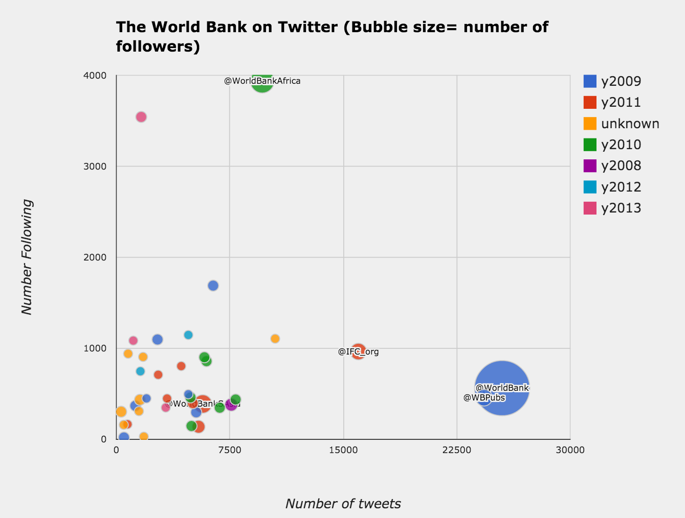
Source: Collected February 1, 2016
Notes:
4 dimensions of data: x-axis, y-axis, bubble size, color

Slide 6
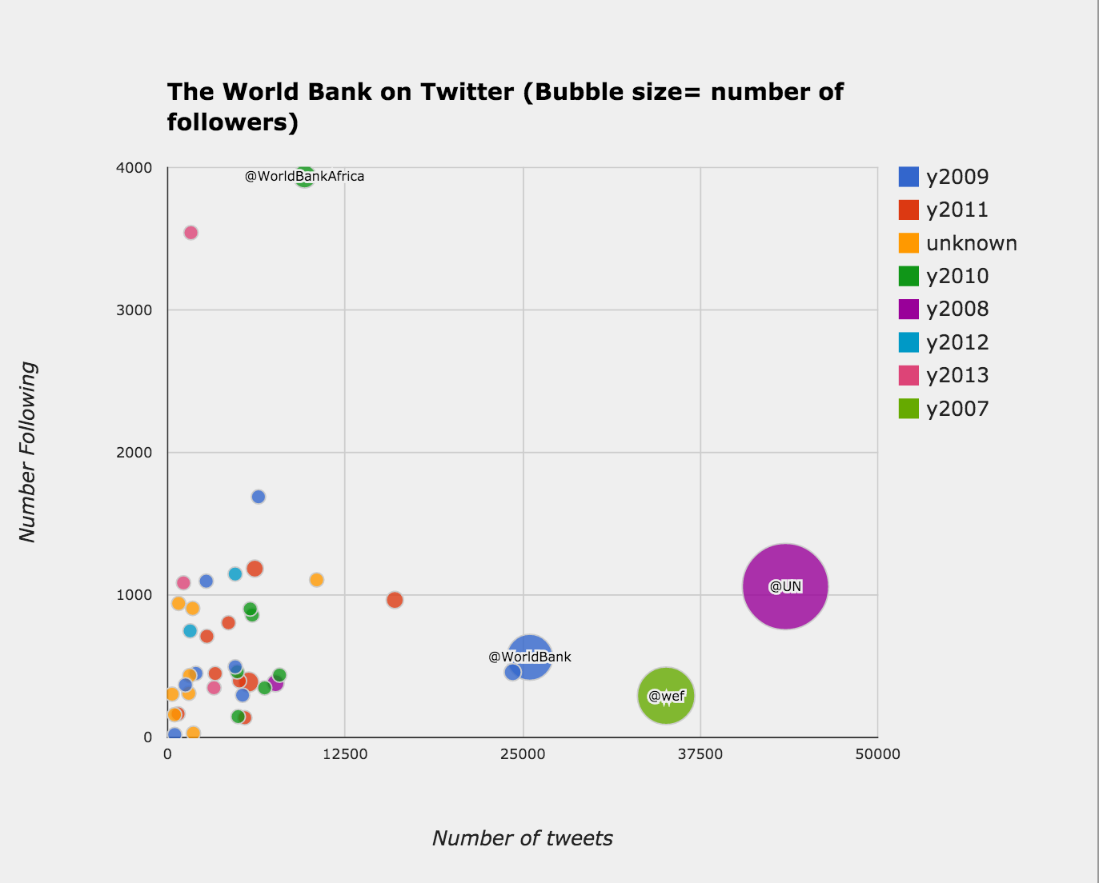
Notes:
World Bank clients are the government and just from the work, civil society (public) is kind of secondary
World Economic Forum hosts the Davos meeting, more about journalism
UN is much bigger as well, perhaps they have more programs engaged directly with people UNHCR

Slide 7
Data

Slide 8
Summary Descriptives
38 World Bank related Twitter accounts
Total 93,733 tweets downloaded
Average of 336-3,200 tweets per account
Maximum tweets allowed to download is 3,200 per account
I downloaded my data in January/February 2016
Keep only ”own” tweets
By user, 6-47 percent of tweets are RTs from other users
71,287 tweets remaining
316 - 3,001 tweets per account
Data over the period March 2009 to February 2016
Notes:
Run by workers not “fans”

Slide 9
Available and Created variables
API |  | Created
ID | User friends count | Dummy: has a hashtag (#)
text | User location | Dummy: is a retweet
created at |  | Dummy: Has a link
Retweet count |  | Dummy: Has an “@”
Favorite count |  | Dummy: user screen names
source |  | Dummy: year
Length |  | List of Hashtags (#)
user screen name |  | List of user tags (@)
user name |  | Clean text
user created at |  | Favorite/retweet count ratio
User description
User followers count
Notes:
WB tweets are from HootSuite which is a software for managing social media.
Not sure why tweets have all times, not just during working hours

Slide 10
Congratulations, @narendramodi, on one year of visionary steps toward ending poverty in #India. The world needs more leaders like you. – JimKim_WBG
Where the extreme poor live
India 33%
China 13%
Nigeria 7%
Bangladesh 6%
DR Congo 5% https://t.co/JrsmBECiSj https://t.co/0lEE80L5m1
-WorldBank

Slide 11
Percent of tweets without favorites or retweets
The World Bank’s main account and the President’s account have the most retweet and favorite activity.

Slide 12
Top @s
 | @user (71,287 tweets) |  | @user (retweets > 50, 1757 tweets) |  | @user (favorites > 50, 944 tweets)
4,773 | worldbank | 110 | jimkim_wbg | 70 | jimkim_wbg
796 | jimkim_wbg | 44 | worldbank | 14 | worldbank
591 | ifc_org | 11 | djokernole | 9 | djokernole
291 | kaushikcbasu | 9 | worldbanklive | 6 | mzveegh
274 | rkyte365 | 8 | un_women | 5 | malalafund
237 | guardian | 8 | mzveegh | 4 | un_women
235 | worldbankdata | 6 | malalafund | 4 | worldbanklive
226 | worldbankafrica | 5 | cgap | 4 | thegef
210 | who | 5 | worldbankrwanda | 3 | narendramodi
210 | un | 5 | un | 3 | worldbankasia

Slide 13
Top Words
 | words |  | words (retweets > 50, 1757 tweets) |  | words (favorites > 50, 944 tweets)
5068 | new | 214 | poverty | 129 | poverty
3620 | world | 130 | women | 88 | cop21
3383 | countries | 124 | countries | 77 | wbg
3345 | help | 122 | wbg | 76 | women
3312 | development | 119 | cop21 | 67 | countries
3308 | women | 115 | africa | 63 | world
3188 | climate | 107 | climatechange | 61 | endpoverty
3152 | poverty | 102 | world | 57 | help
3139 | blog | 102 | endpoverty | 56 | access
2920 | africa | 101 | ppl | 54 | people
Notes:
Note the words also includes the hashtags

Slide 14
Top hashtags
 | hashtags |  | hashtags (retweets > 50, 1757 tweets) |  | hashtags (favorites > 50, 944 tweets)
2,314 | africa | 116 | cop21 | 87 | cop21
2,172 | india | 107 | climatechange | 61 | endpoverty
1,689 | climatechange | 102 | endpoverty | 46 | poverty
1,561 | socent | 97 | africa | 38 | africa
1,465 | opendata | 80 | poverty | 36 | climatechange
1,353 | ppps | 44 | climate | 24 | education
1,278 | endpoverty | 35 | education | 20 | climate
1,266 | poverty | 31 | data | 20 | india
1,225 | climate | 29 | india | 20 | wdr2016
1,224 | cop21 | 28 | wdr2016 | 16 | solar

Slide 15
Analysis

Slide 16
Analysis
Word counts and Token likelihood
What words are more or less common in favorite and RTs
Topic Modelling
Which types of tweets get the most retweets or favorites?
Predictions
Non-text (has @, has link, has #)
Text based
Sentiment analysis

Slide 17
Token Likelihoods: which words are in the high favorite and retweet counts
Most common words are not revealing of popular tweets, they are overused (poverty, world bank)
Likelihood ratios are not as high as in the spam/ham example
All accounts
5213 words
@WorldBank:
713 words

Slide 18
Notes:
These are the most common words, which are not descriptive of the likelihood of whether they are retweeted or not.

Slide 20
Topic Modeling (all accounts)
Private PPPs
Help
Sector Public
Join live credit event worldbank
Women gender new violence get2equal
Finance Worldbank Development Growth New
Financialinclusion finaccess smes access india
IFC ora new worldbank africa
Farmers Food climate agriculture energy

Slide 21
Predictions
Logistic regression
Y= Dummy has a retweet
X1=has@, has link, has#
X2=has@, has link, has#, dummy of WB accounts
X3= document term matrix of tags
X4= document term matrix of cleaned text (note text includes tags)
Notes:
Y variable whether favorite or retweet has a similar result

Slide 22
Y=has a retweet Cols=['has_at', 'has_ht', 'has_link']
Testing accuracy: 0.711311
Null accuracy: 0.711312
AUC: 0.557
C-V AUC: 0.547
Y=has a retweet Cols=['has_at', 'has_ht', 'has_link’, all user dummies]
Testing accuracy: 0.755
Null accuracy: 0.71131
AUC: 0.795
C-V AUC: 0.215
Notes:
User explains a lot of the predicting
71.1% of tweets has a retweet

Slide 23
Y=has a retweet Cols=[document term matrix tags]
Testing accuracy: 0.727
Null accuracy: 0.711312
AUC: 0.679
C-V AUC:
Y=has a retweet Cols=[document term matrix text]
Testing accuracy: 0.687
Null accuracy: 0.711312
AUC: 0.651
C-V AUC:
Notes:
User explains a lot of the predicting
71.1% of tweets has a retweet
Words don’t matter as much as which user tweets it

Slide 24
Columns of characteristics (@, #, link) is not predictive
Words predict retweet incidence OK but not as well as user dummies
Comparison of the main World Bank twitter account is not really comparable with others so focus only on the account @WorldBank for the text analysis
→ Look at the @WorldBank account only
Notes:
Probably too much noise examining all accounts so focus on World Bank only

Slide 26
Where the extreme poor live India 33% China 13% Nigeria 7% Bangladesh 6% DR Congo 5% https://t.co/JrsmBECiSj https://t.co/0lEE80L5m1
Where are the cheapest and most expensive countries to own a mobile phone? https://t.co/prIZ4f0w6R #WDR2016 https://t.co/5LTuBq2Np5
#SriLanka is the cheapest place for mobile. See the most expensive: https://t.co/UEWj1UM3Du #WDR2016 https://t.co/AUFsDCpA9K

Slide 27
Topics (@WorldBank)
cities servingecd sdgs jobs globalgoals
join gs discussion ask youthbiz
apply specialist transport encouraged women
wbg jimkim women endpoverty access
wbg jimkim poverty report action
musicnegrito goodgov citizen winner kenyapower
djokernole servingecd children pmr carbon
energy women apply jobs ppl
poverty countries women unga wbg
electricity climateaction safe affordable cop
← All Tweets
Retweet Count >30 →
carbon help low countries cities
globalcitizen africa flipboard womenbizreview poverty
Notes:
Talking about other people helps

Slide 28
Notes:
Words that are predictive tend to be event oriented

Slide 30
@WorldBank
Notes:
Are any of this user driven since virtually all of the @WorldBank tweets are liked and favorited
The world bank does use different words

Slide 31
Sentiment (@worldbank)
← By Retweet counts
Sentiment is slightly skewed to the positive
By favorite counts →
Notes:
Clean text does worse than unclean text

Slide 32
Conclusions

Slide 33
Conclusion
Need to interact more broadly with people
Cross tag people and hashtags
What do people tweet about
Internal WB events and publications
WB findings
International events
Notes:
Subgroups should be local?

Slide 34
Thank you!
Judy: judy.s.yang@gmail.com

